Slide 1


Final Cooling with Thick Wedges for a Muon Collider
Daniel Fu, University of Chicago
Advisor: Karri DiPetrillo
19 May 2025

Slide 2
What is a Muon Collider?
Proton-proton colliders
Electron-positron colliders
Can accelerate to high energy in circular collider
Effective for particle searches
Composite particle; only ~10% of collision energy used
Interaction energy is variable and difficult to model
Elementary particle, so collision is 100% efficient
Precision measurements can be performed with energy tuning
Synchrotron radiation limits energy in circular collider

Slide 3
What is a Muon Collider?
A muon collider would collide muons and antimuons
Muons are elementary particles → whole energy of collision used in interaction
Muons are more massive than electrons → synchrotron radiation losses minimal
As a lepton collider, it can perform precision measurements
Potential to explore new physics with smaller footprint and lower cost
A 10 TeV muon collider would have physics reach similar to a 100 TeV proton collider like the FCC in a facility the size of the LHC

Slide 4
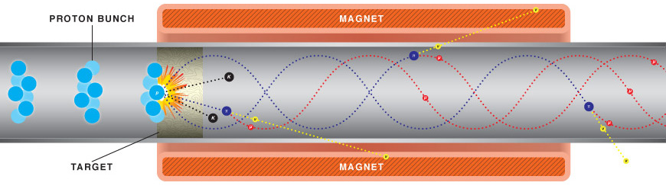
Muon production
Muons are unstable, must produce, accelerate, and collide them before they decay
Proton-target collisions produce pions, which decay into muons
Source: CERN

Slide 5
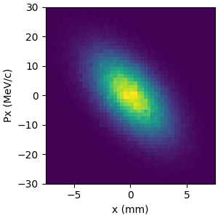
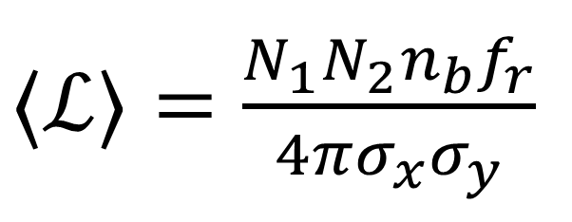
Emittance and Cooling
Emittance = area of distribution in phase-space
Initial high variance in muon position and momentum – measured by emittance
Emittance measured in longitudinal (parallel to beam) and transverse (perpendicular to beam) axes
Reducing emittance is necessary for building a collider; this process is known as cooling
Final stages of cooling specifically decrease transverse emittance – emittance exchange
$⟨ℒ⟩=\frac{N_{1}N_{2}n_{b}f_{r}}{4πσ_{x}σ_{y}}$
Variances in position related to transverse emittance

Slide 6
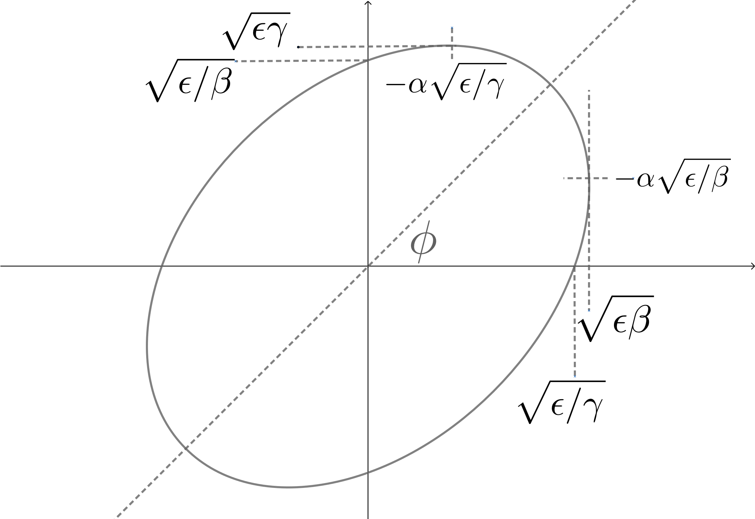
Background: Courant–Snyder parameters
Describe particle distribution in position-momentum (phase) space
Emittance measures the size of the distribution
β (beta) measures the physical size of the beam (lower beta = stronger focusing)
α (alpha) indicates whether the beam is converging or diverging
Measured on each axis

Slide 7
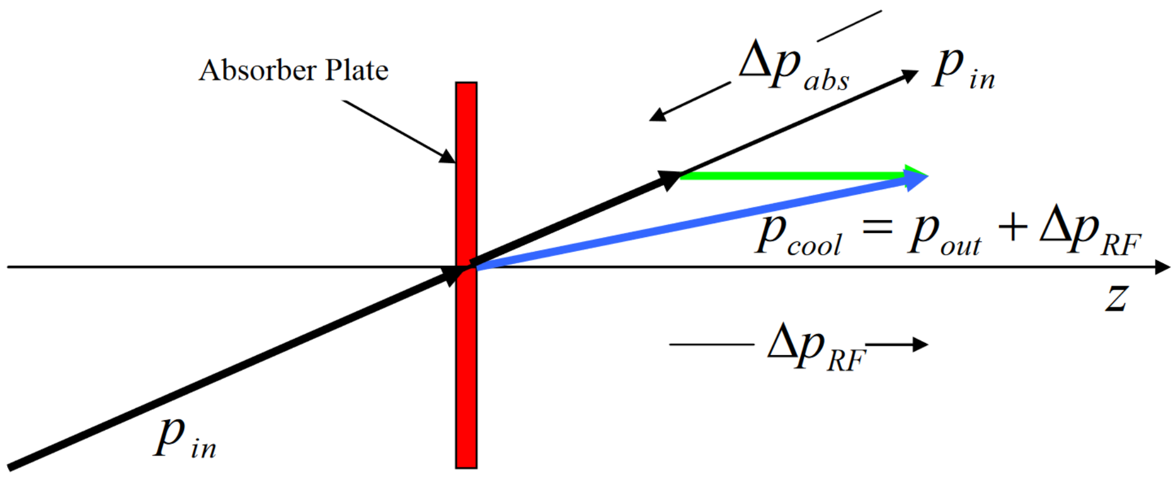
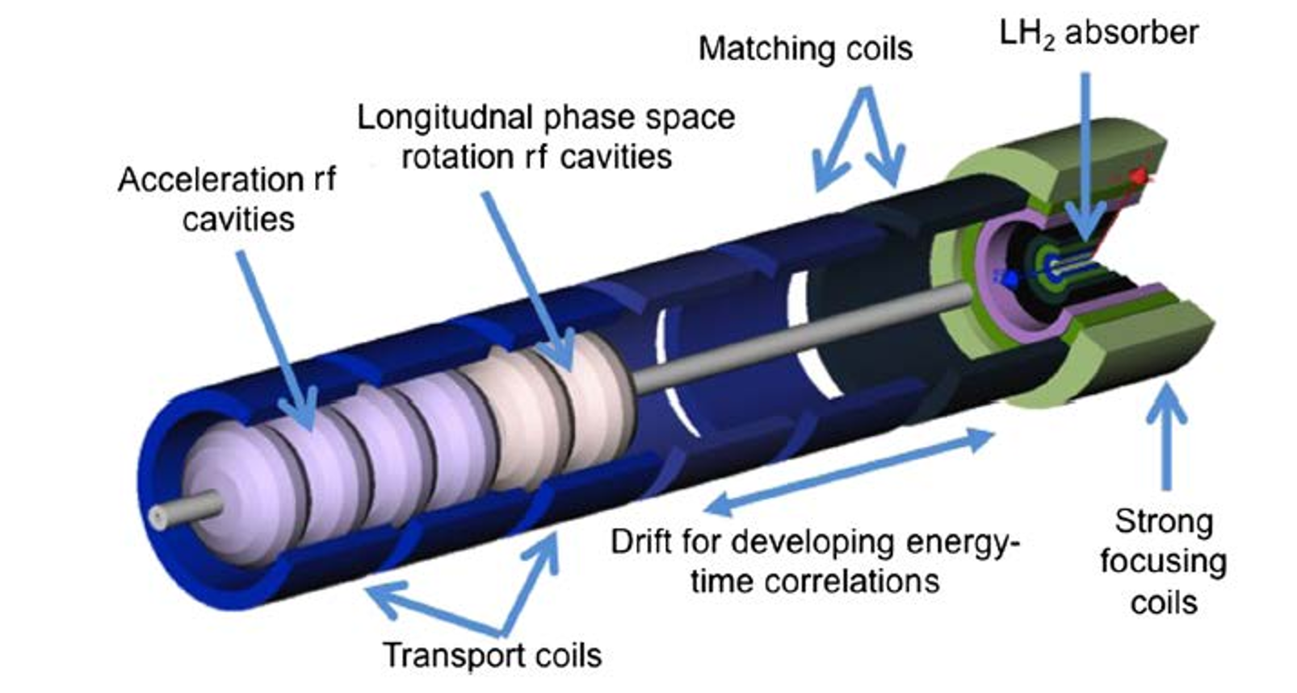
Ionization Cooling
Used because of short muon lifetime
Beam passed through matter, loses energy through ionization
Momentum reduced in all axes (transverse and longitudinal)
Beam reaccelerated in RF cavity
Ends with greater proportion of momentum in longitudinal direction, achieving cooling

Slide 8
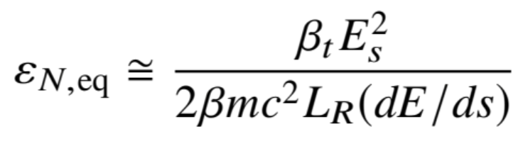
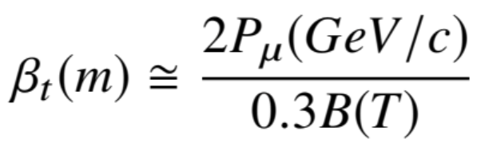
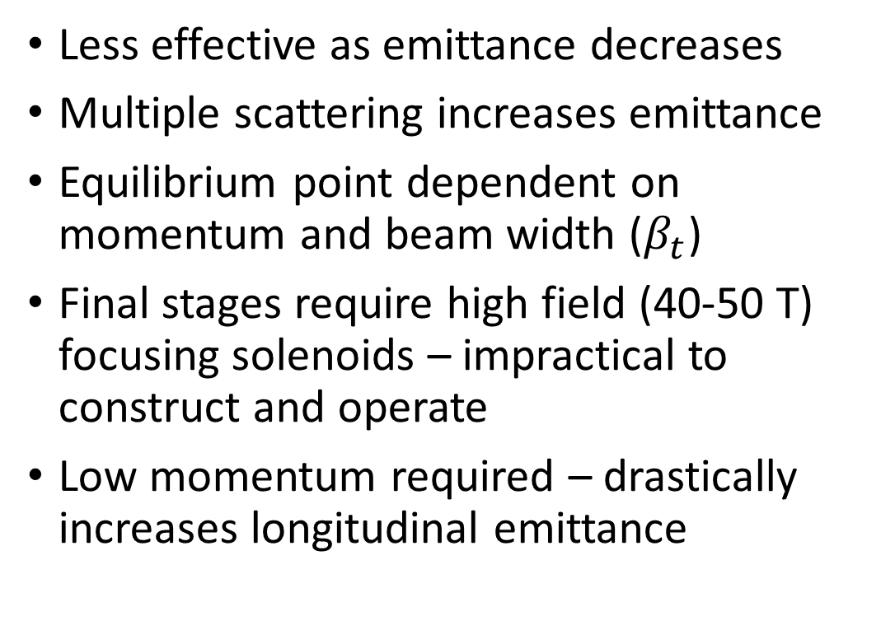
Problems with Ionization Cooling
Less effective as emittance decreases
Multiple scattering increases emittance
Equilibrium point dependent on momentum and beam width ($β_{t}$)
Final stages require high field (40-50 T) focusing solenoids – impractical to construct and operate
Low momentum required – drastically increases longitudinal emittance

Slide 9
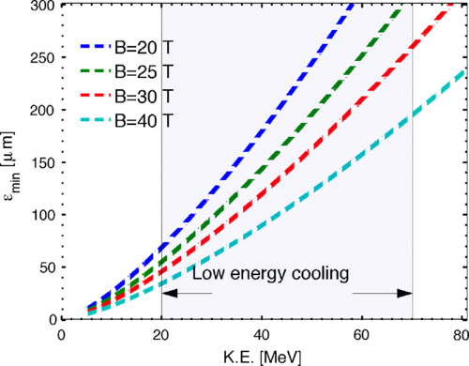
Problems with Ionization Cooling
Achieving low emittances requires high magnetic fields and low momentums

Slide 10
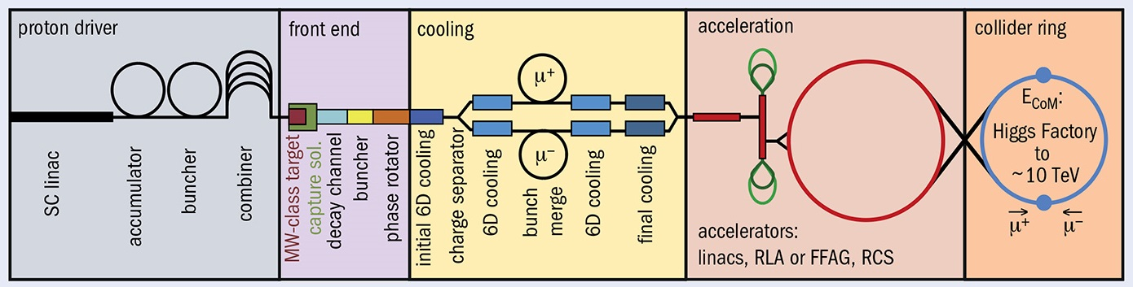
Final Cooling with Thick Wedges
Conceptual final cooling design proposed in 2017
Utilizes wedge-shaped absorbers to achieve emittance exchange
Lower magnetic field requirements than other methods

Slide 11
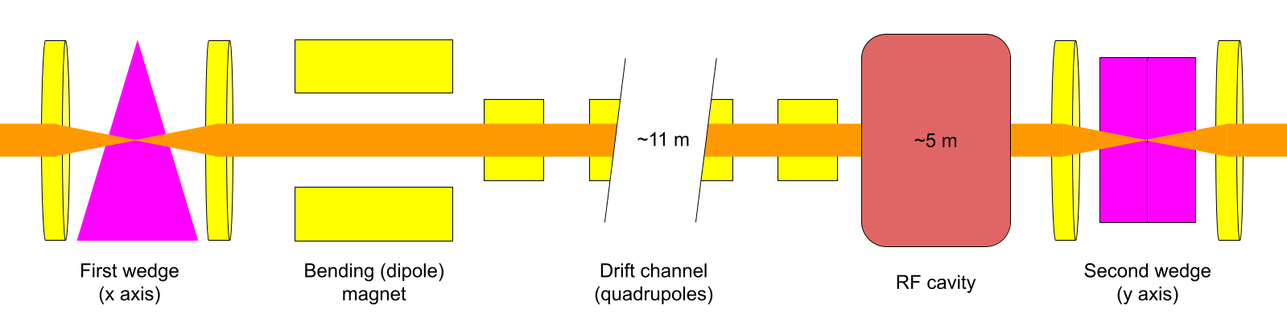
Final Cooling with Thick Wedges
Conceptual final cooling design proposed in 2017
Utilizes wedge-shaped absorbers to achieve emittance exchange
Lower magnetic field requirements than other methods

Slide 12
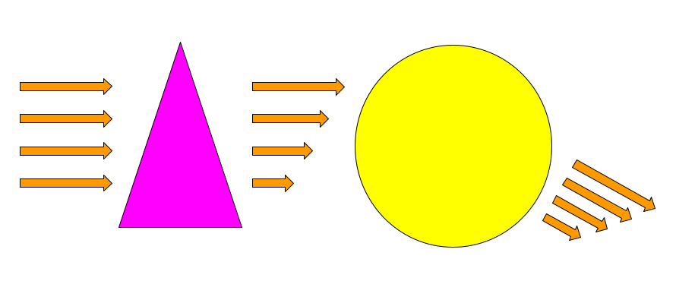
Wedge Cooling Mechanism
3. Bending magnet deflects particles by amount proportional to momentum
2. Muons encounter varying amounts of wedge material, thus decelerate by different amounts
1. Beam enters wedge absorber
4. Resulting beam has lower transverse emittance but higher spread in longitudinal momentum

Slide 13
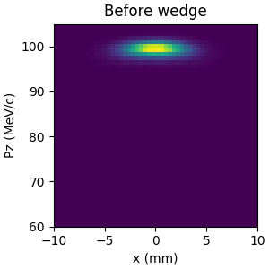
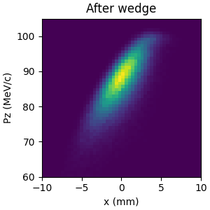
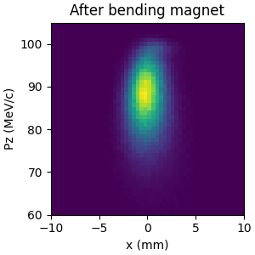
Wedge Cooling Mechanism

Slide 14
Phase Rotation
Decreases longitudinal momentum spread at the cost of increasing longitudinal position spread (longitudinal emittance unchanged)
Drift channel: faster muons outpace slower ones
RF cavity: apply time-varying E field to accelerate faster muons and decelerate slower muons

Slide 15
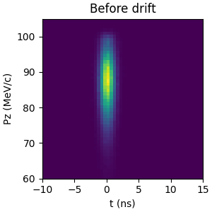
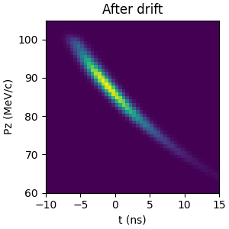
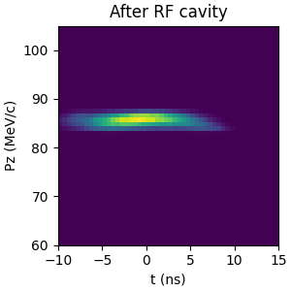
Phase Rotation
Decreases longitudinal momentum spread at the cost of increasing longitudinal position spread (longitudinal emittance unchanged)
Drift channel: faster muons outpace slower ones
RF cavity: apply time-varying E field to accelerate faster muons and decelerate slower muons

Slide 16
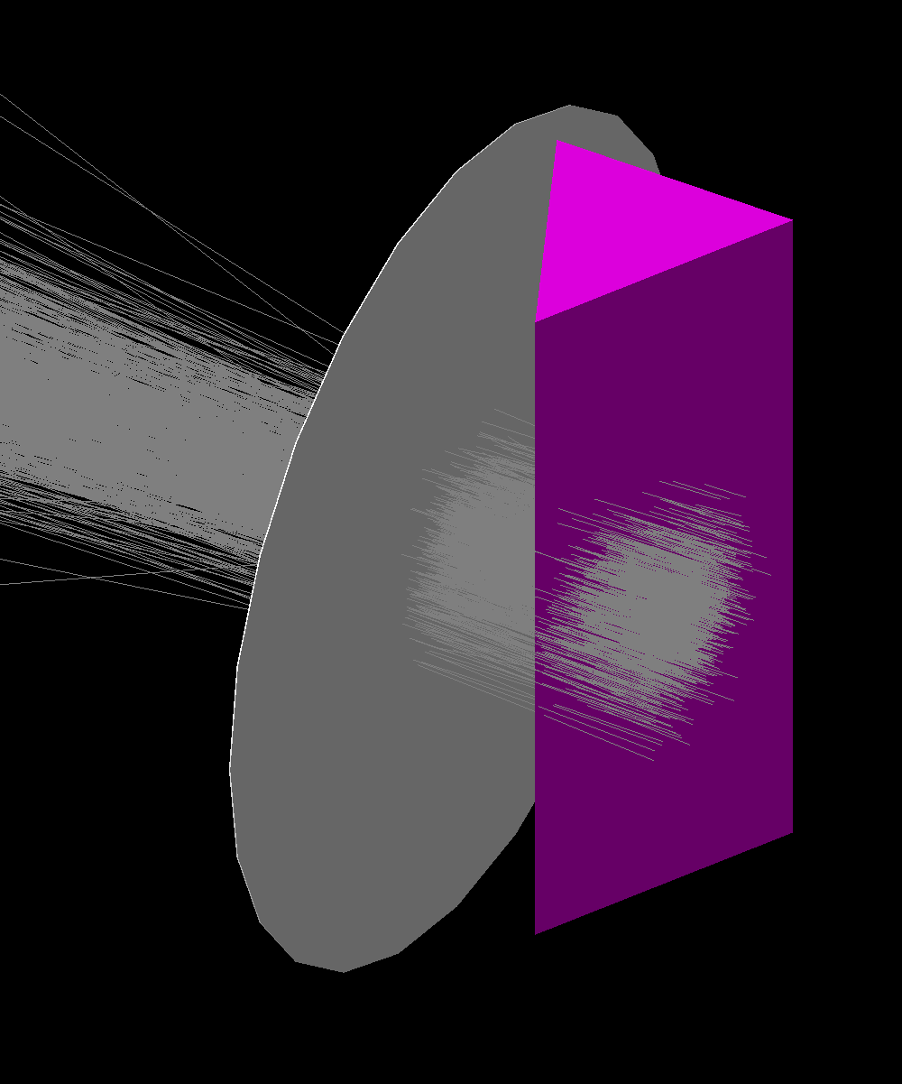
Prior work
I studied this method at Fermilab in Summer 2023
Used simulation software G4Beamline and optimized wedge parameters (length, half-angle) using Nelder-Mead method
Found that lower emittances can be achieved compared to other cooling methods proposed
Substantial assumptions made; portions left unmodeled
Example G4Beamline simulation
Green: Modeled in summer 2023

Slide 17

Prior work
Continued working on this project through 2023-24 academic year
Evaluated simulation accuracy v.s. particle count and step size
Joined by Ryan Michaud, who modeled the drift channel in MAD-X
Ryan Michaud
Green: Modeled in summer 2023
Blue: Modeled by Ryan in 2023-24

Slide 18
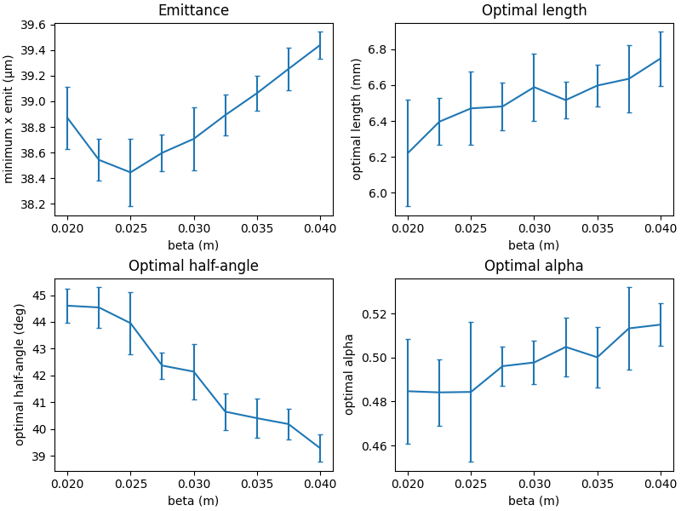
Results: Wedge
Performed simulations to characterize effect of beta and alpha on wedge performance
Varied beta while optimizing wedge length, wedge half-angle, and beam alpha at each point
Repeated trials to account for stochastic effects
Minimum emittance attained at beta of around 0.025 m

Slide 19
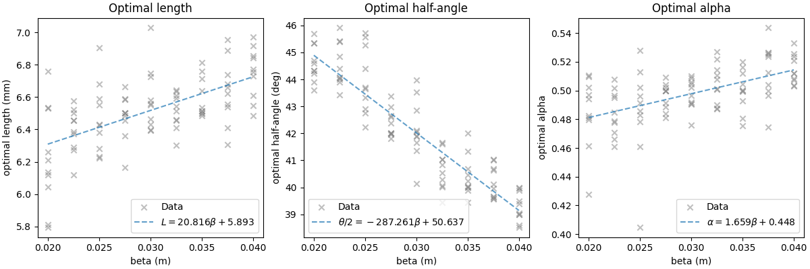
Results: Wedge

Slide 20
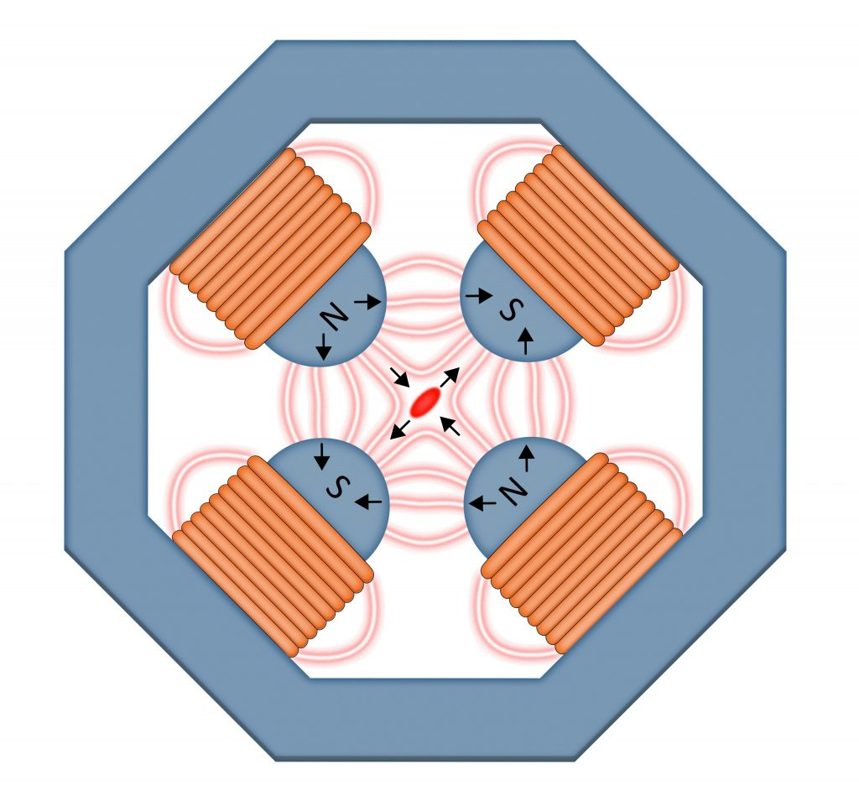
Results: Drift Channel
Quadrupoles focus beam in one axis and defocus in another
Alternating quadrupoles achieve focusing in both axes
Called a FODO (focus-open-defocus-open) array
Each repeating cell should be periodic
Diagram of a quadrupole magnet
Model of a FODO array
Beam converging in x, diverging in y
Beam diverging in x, converging in y

Slide 21
Differences between MAD-X and G4Beamline
G4Beamline
MAD-X
Tracks many individual particles
Considers all distribution parameters
Detailed magnetic fields
Not easy to perform optimization
Magnet strength measured in B field gradients
Tracks distributions of particles
Only beta/alpha considered
Approximations for magnets
Fast optimization for magnets
Magnet strength described by quadrupole coefficient

Slide 22
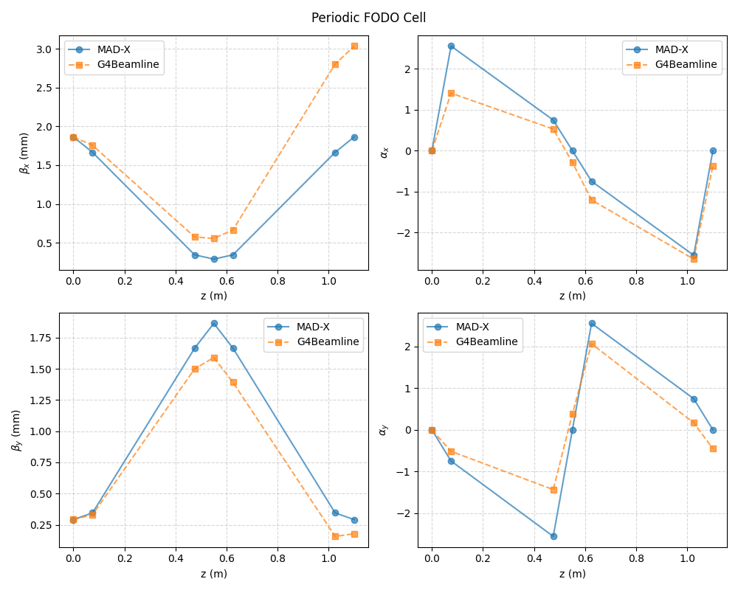
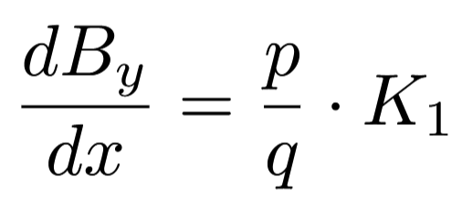
Drift channel in G4Beamline
Translated design of periodic FODO cell from MAD-X to G4Beamline
Converted quadrupole coefficients to B field gradients
Found discrepancies between MAD-X and G4Beamline results

Slide 23
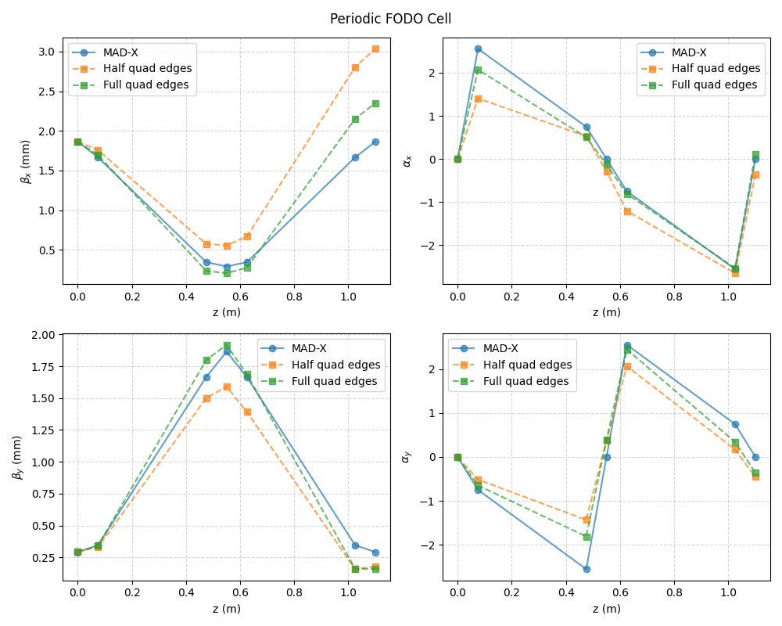
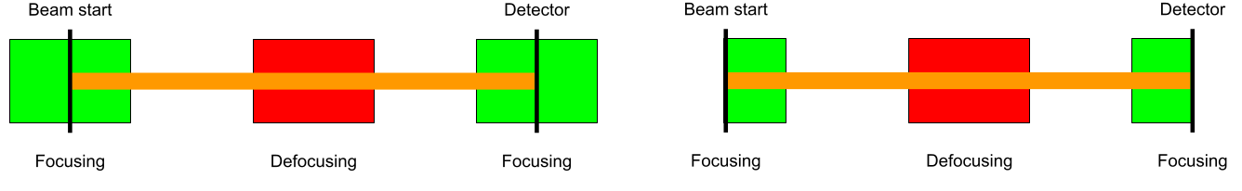
FODO cell edges
MAD-X does not account for fringe fields, but G4Beamline does
Using a different layout (shown below) in G4Beamline produced better results
However, models still do not match
Layout in G4Beamline
Layout in MAD-X

Slide 24
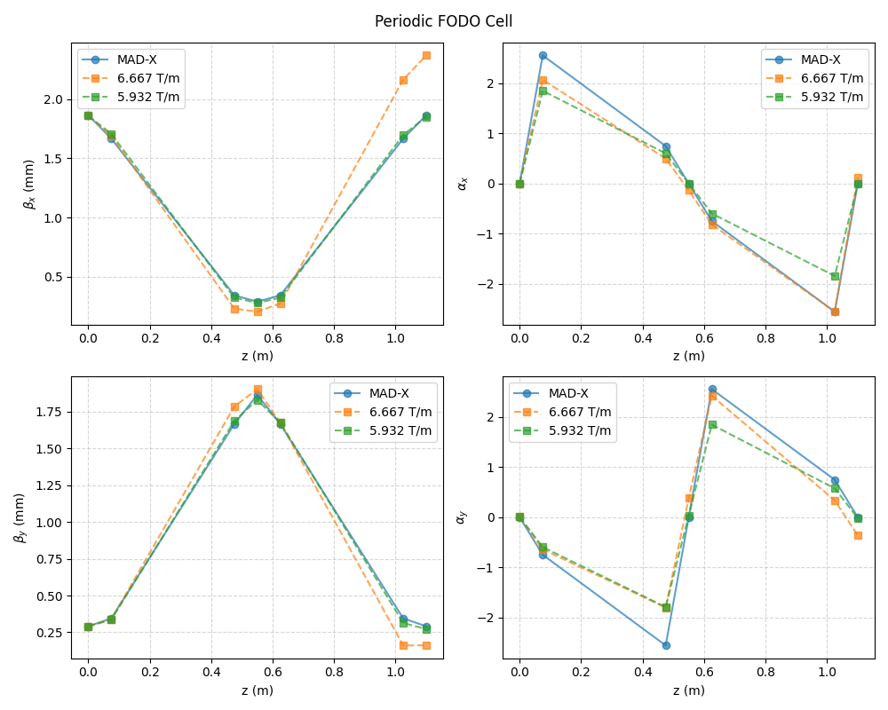
Optimizing Magnet Gradients
Ran optimization to minimize difference in beta in G4Beamline
Found a slightly lower magnetic field gradient than in MAD-X (5.932 T/m vs. 6.667 T/m)
Beta curves match closely, but alpha curves differ
Unsure why this difference exists

Slide 25
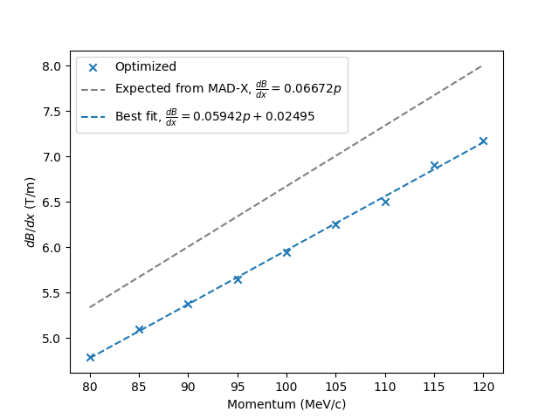
Optimizing Magnet Gradients
Ran optimization at different momentums
Difference between MAD-X and G4Beamline values seems linear

Slide 26
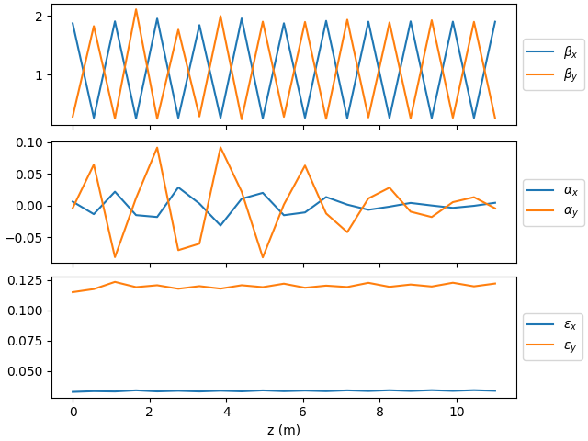
Entire drift channel
11 periodic cells combined into full channel
Used values typical for beam after first wedge
Beta, alpha, and emittance values behave as expected

Slide 27
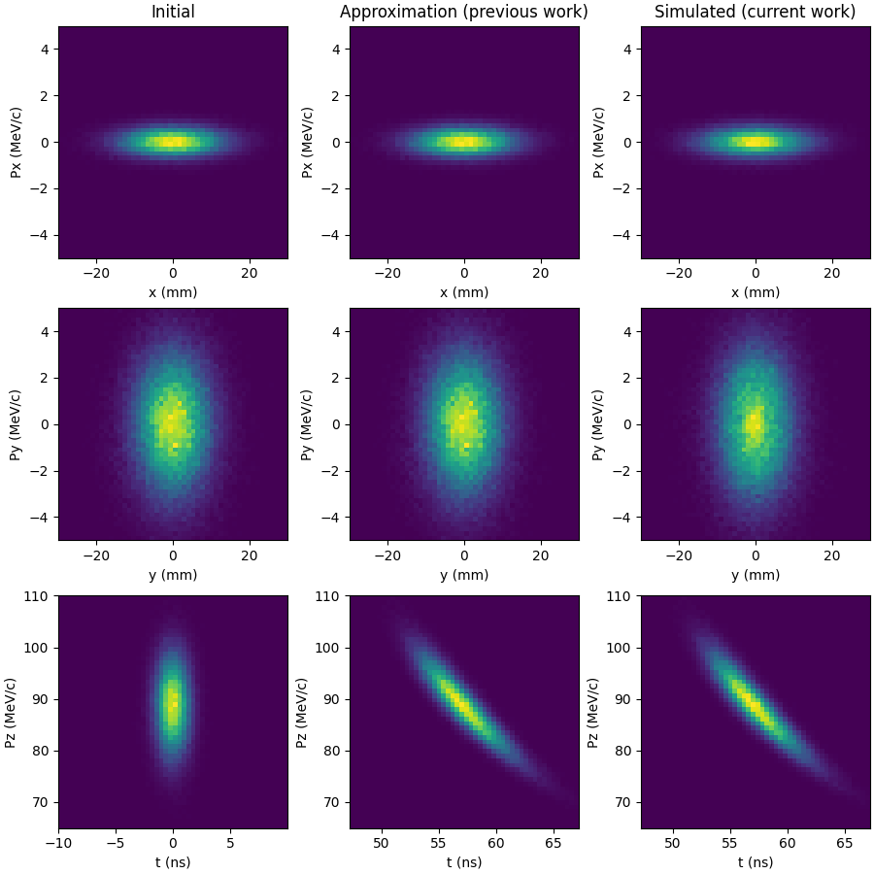
Entire drift channel
Compared distribution before and after channel
Also compared to approximation used in 2023
Distributions in x and y appear to be preserved
Correlation develops between longitudinal position + momentum
Results closely match approximation

Slide 28
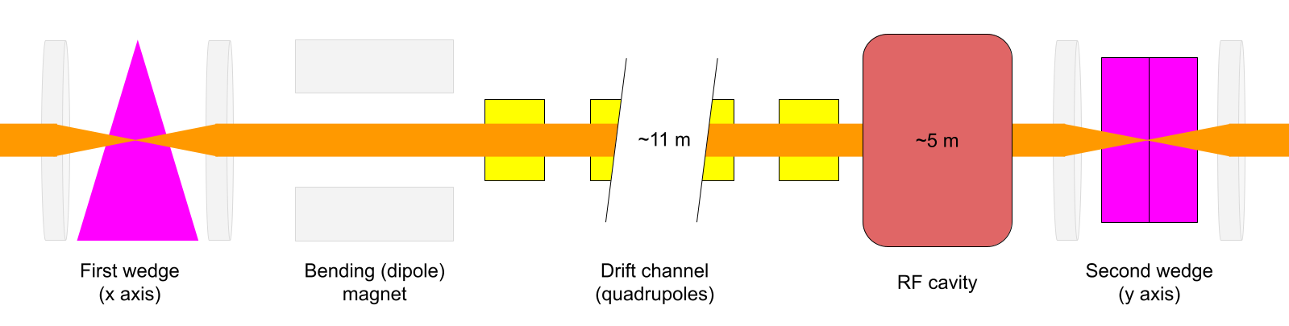
Conclusions
Characterized effect of beta and alpha on wedge
Determined that an optimal beta value exists
Found discrepancies between MAD-X and G4Beamline simulations of drift channel
Produced functional drift channel in G4Beamline

Slide 29
Next Steps
Design:
Focusing solenoids around wedges
Quadrupole lattice around RF cavity
Bending magnet(s)
Continue investigating MAD-X v.s. G4Beamline discrepencies

Slide 30
Acknowledgements
Karri DiPetrillo
Diktys Stratakis
David Neuffer
Ryan Michaud
Eliana Gianfelice-Wendt
Anthony Badea

Slide 31
Backup slides

Slide 32
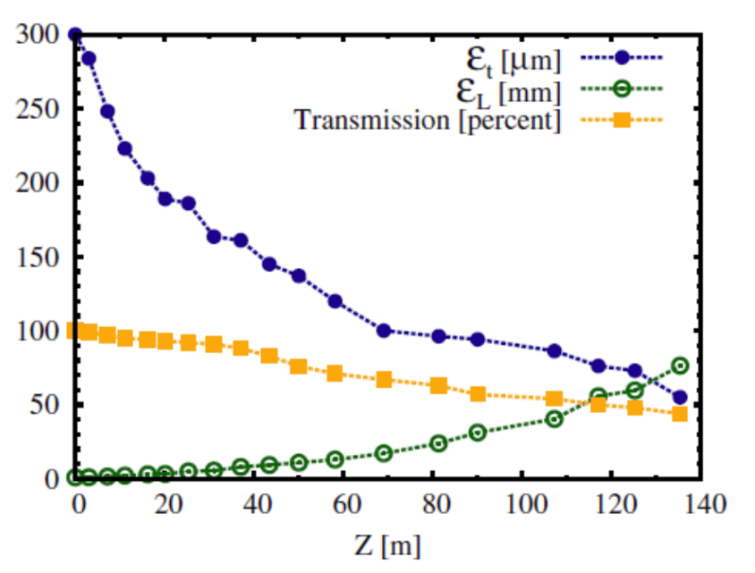
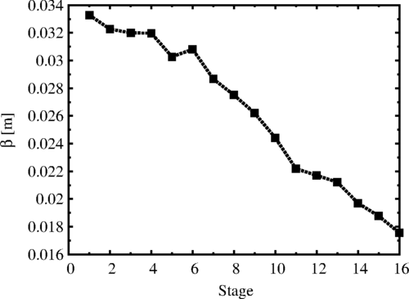
Baseline Graphs
Source: 1612.08960
Source: 10.1103

Slide 33
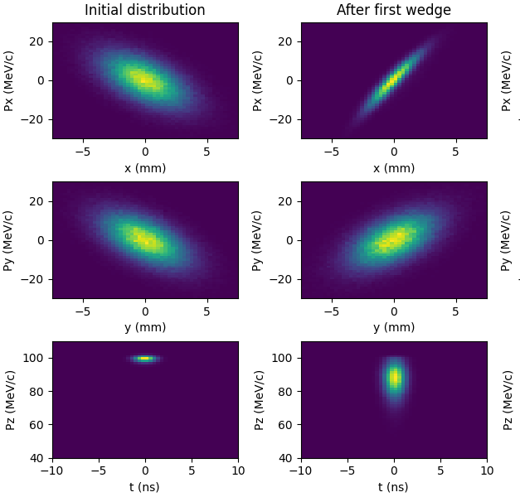
Wedge Cooling Mechanism
Emittance in axis of wedge (x) decreases
Emittance in second transverse axis (y) unchanged
Emittance in longitudinal (z) axis increases due to increased spread in momentum
Momentum spread must be reduced before second wedge

Slide 34
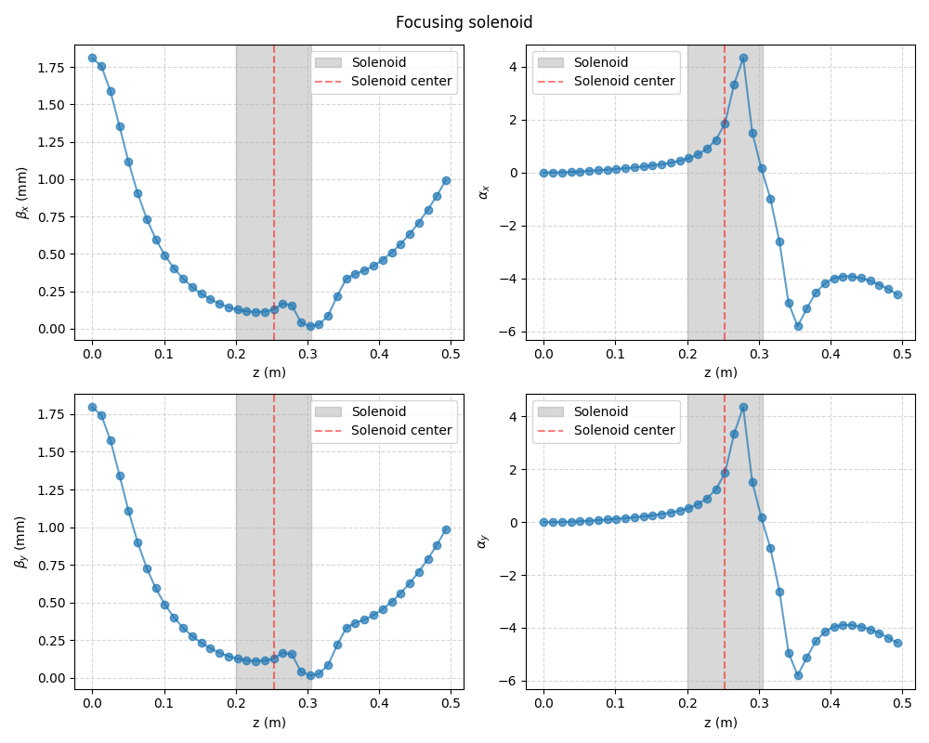
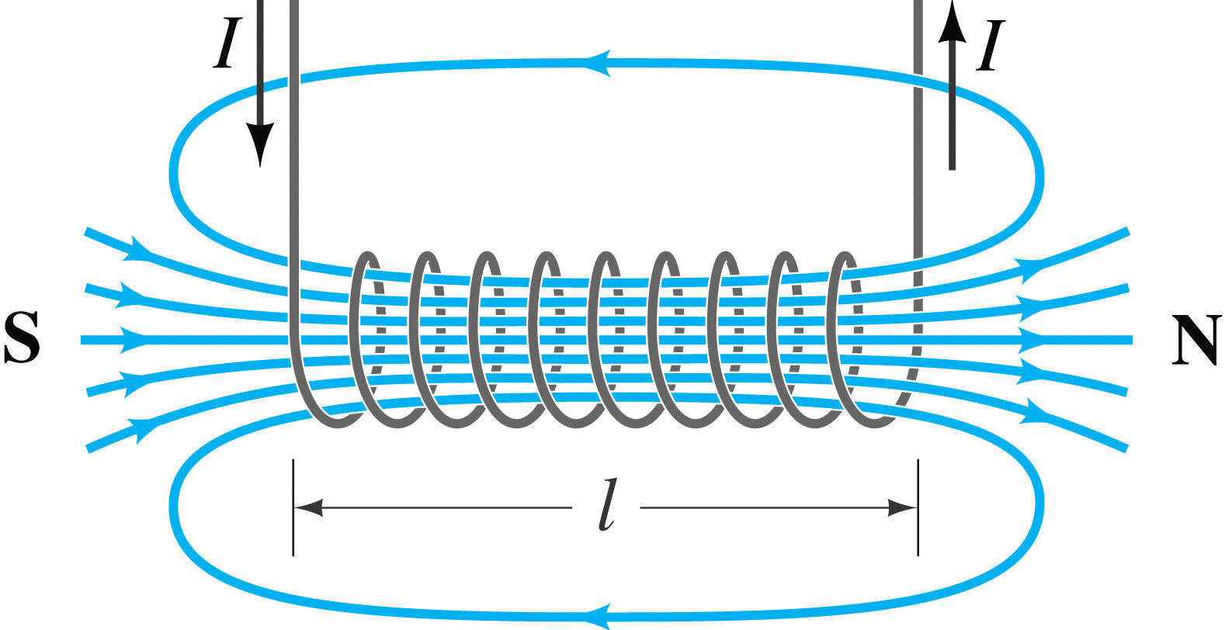
Initial work on solenoids
Particles follow a helical trajectory in a solenoid, leading to focusing

Slide 35
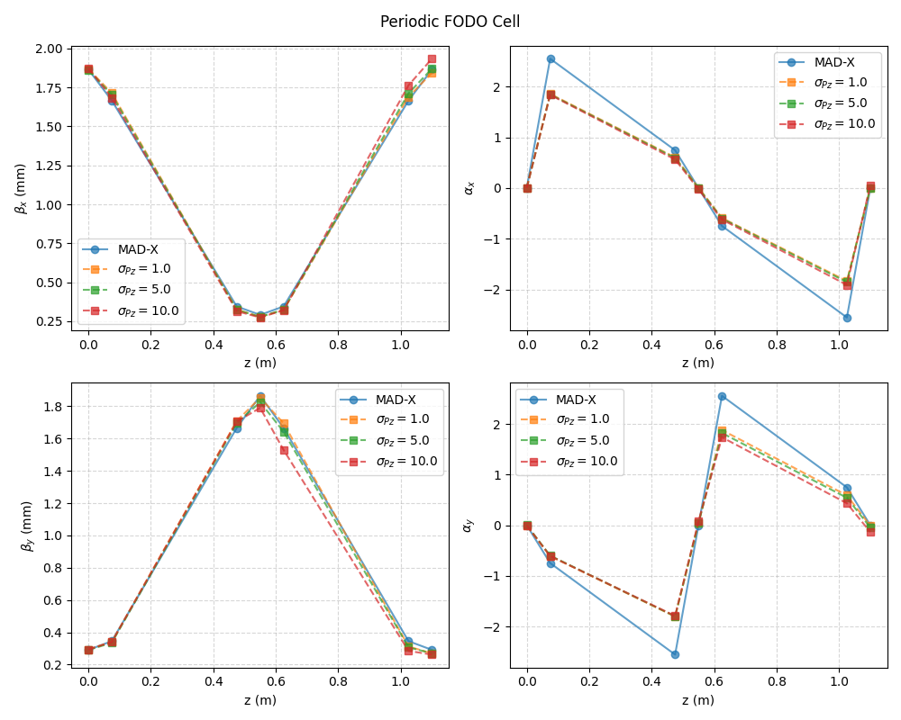
Effect of momentum spread

Slide 36
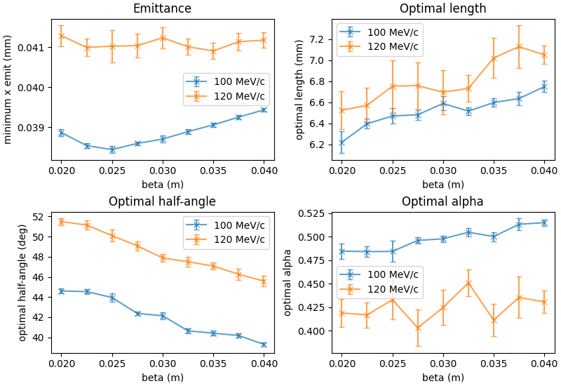
Effect of momentum

Slide 37
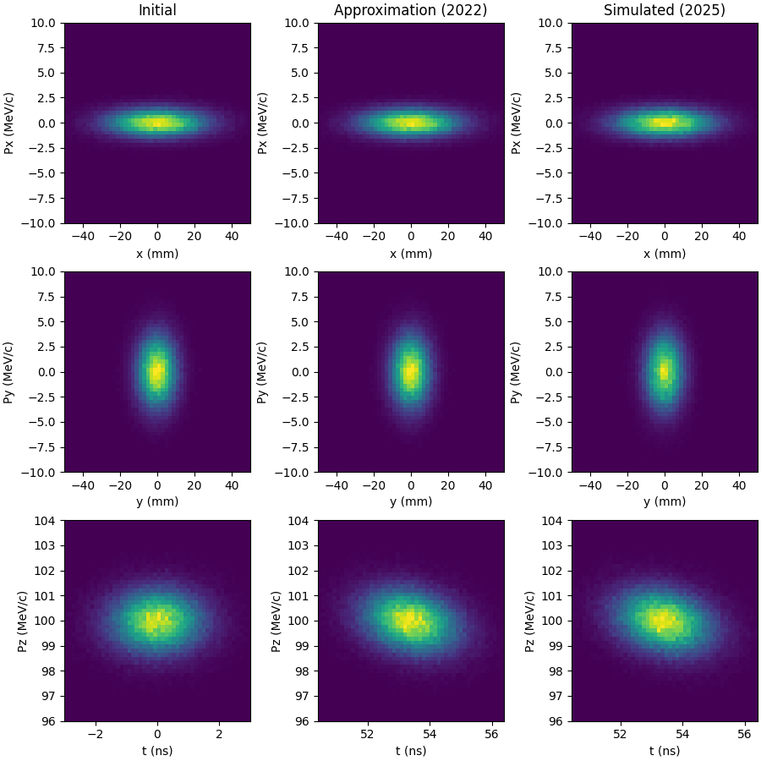
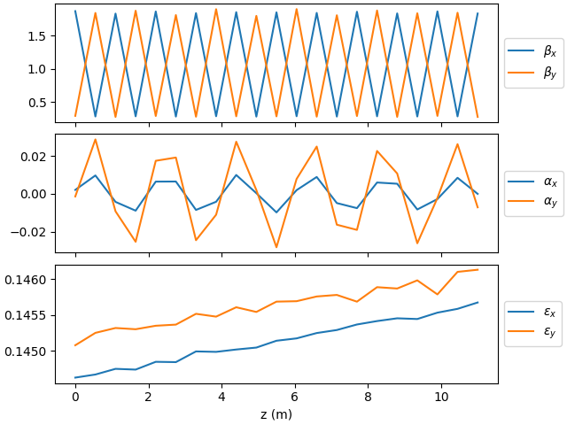
Entire drift channel

Slide 38
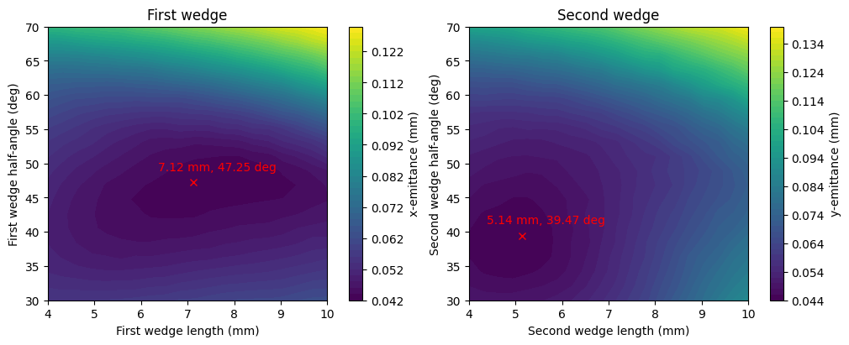
Simulation and Optimization
Simulated using G4Beamline software
Optimization conducted using Nelder-Mead method (scipy)
Optimized 1st wedge, drift length, RF cavity, and 2nd wedge sequentially
Left: Example G4Beamline simulation
Right: Optimal parameters for the first and second wedges

Slide 39
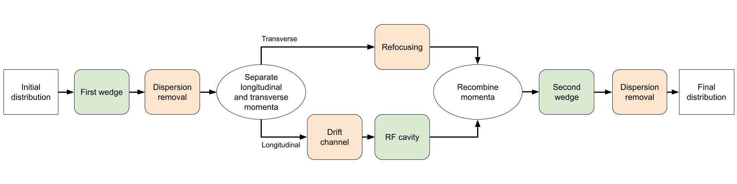
Caveats and Assumptions
Magnets for focusing, beam transport, and bending were not designed – idealized versions assumed
Required magnet strengths not precisely known
Only longitudinal behavior was considered in the RF cavity
Losses from muon decays and inter-particle interactions ignored
Green: Step simulated in G4Beamline
Orange: Step not simulated; assumptions made

Slide 40
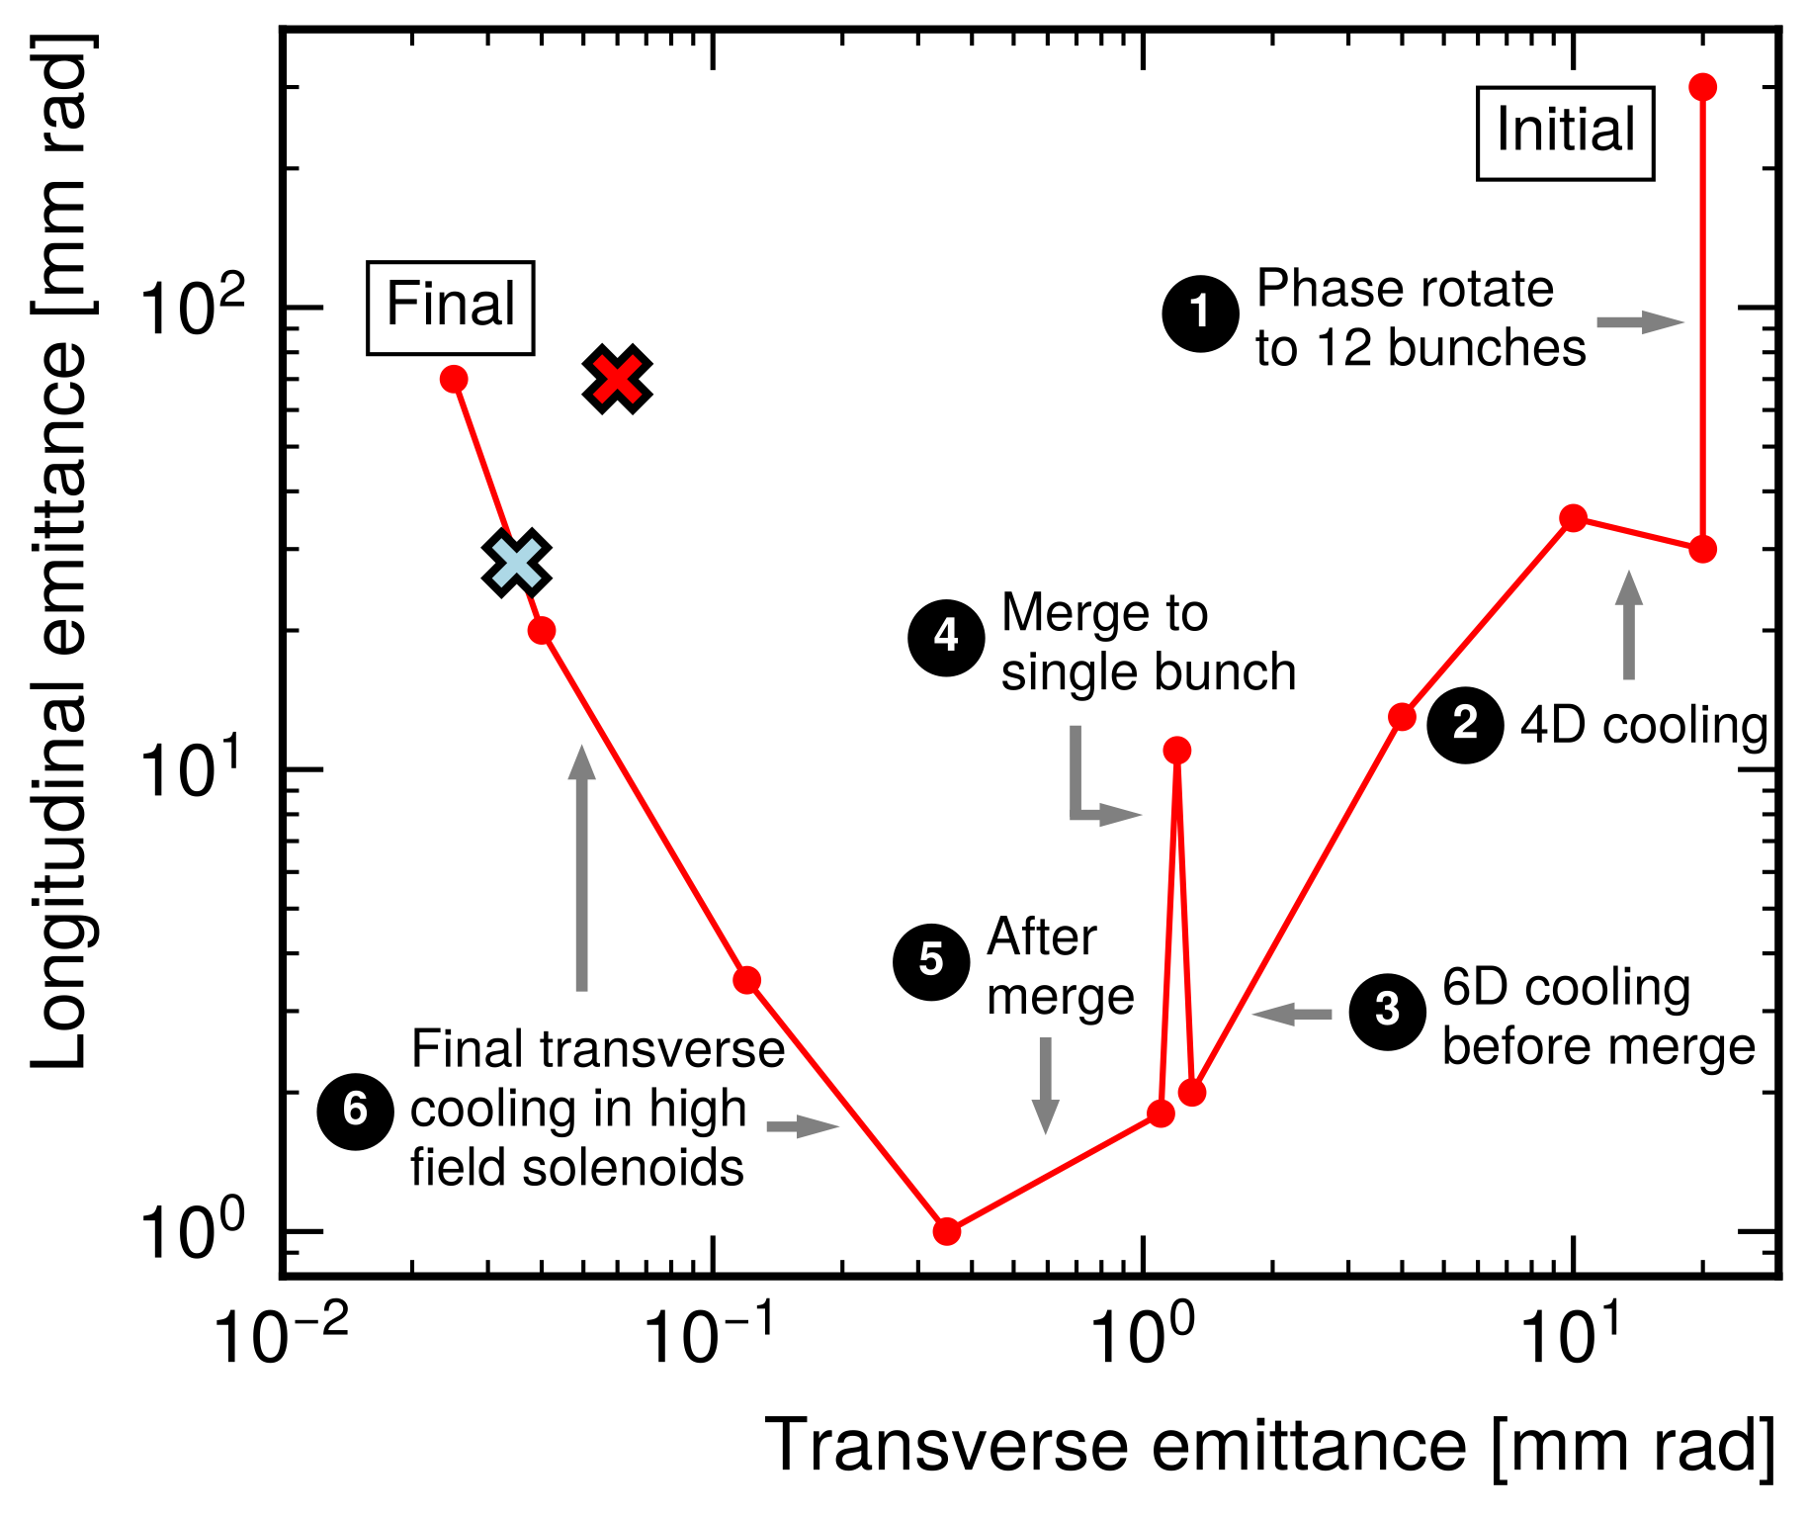
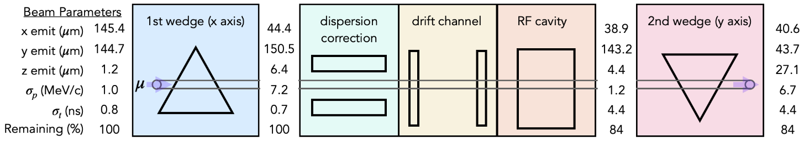
Summer 2023 Results
Optimized conceptual design
Achieved lower transverse emittance (x) than previous best results (x)
Demonstrated cooling from first and second wedges

Slide 41
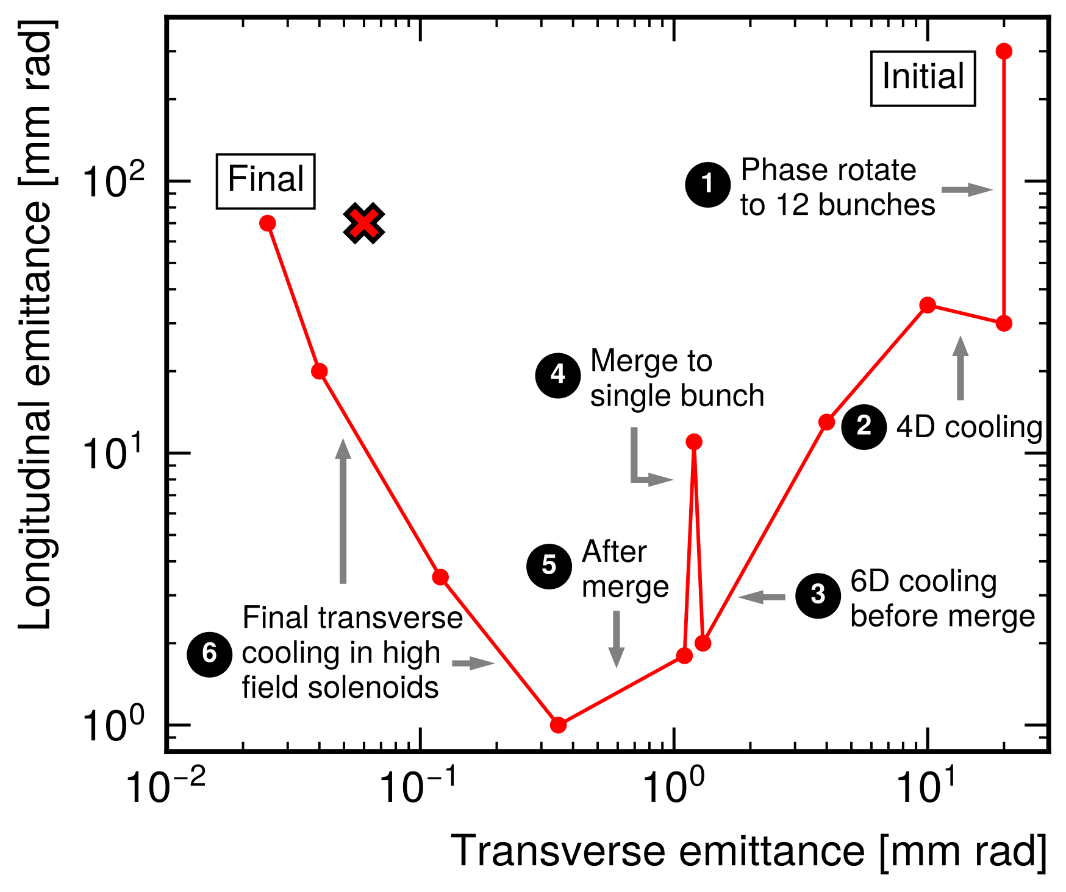
Final Cooling
Cooling occurs in several stages
Initial stages reduce emittance in all axes (6D cooling)
Final cooling reduces transverse emittance, longitudinal emittance allowed to grow (4D cooling)
Target emittance around 30 μm transverse, 100 mm longitudinal
I am studying this final cooling stage
Source: Fermilab

Slide 42
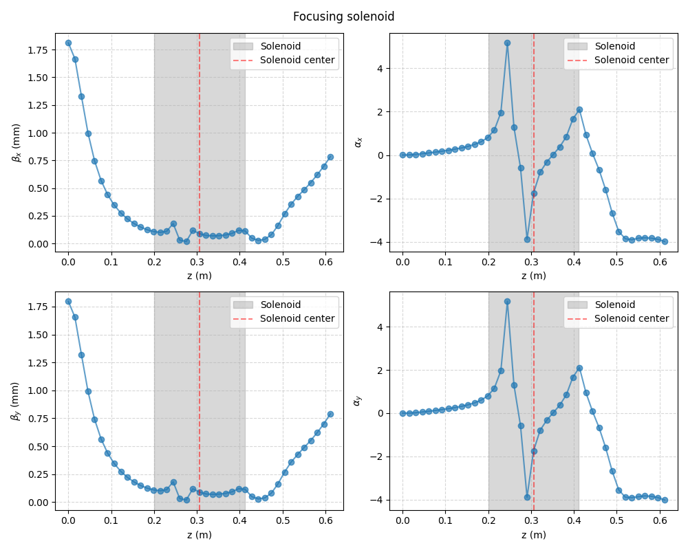
Solenoid

Slide 43
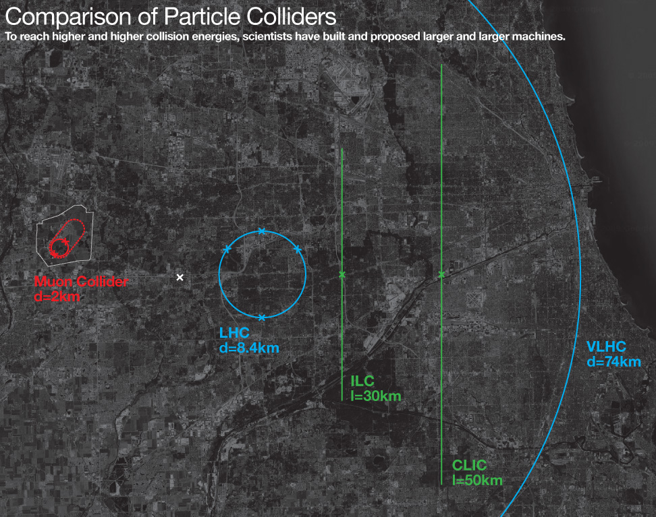
What is a Muon Collider?
Current particle accelerators use protons or electrons
Electrons lose energy to radiation – harder to reach high energy
Protons are composite particles – collisions inefficient and complex
Muons are high mass, elementary particles – best of both worlds
Potential to reach new energy scale (10+ TeV) with smaller footprint and lower cost
Source: Fermilab

